Slide 1
Mobile Communications
Chapter 1: Introduction
A case for mobility
History of mobile communication
Market
Areas of research
1.0.1

Slide 2
Computers for the next century?
Computers are integrated
  small, cheap, portable, replaceable - no more separate devices
Technology in the background
  computer are aware of their environment and adapt (“location awareness”)
  computer recognize the location of the user and react appropriately (e.g., call forwarding, fax forwarding)
Advances in technology
  more computing power in smaller devices
  flat, lightweight displays with low power consumption
  new user interfaces due to small dimensions
  more bandwidth per cubic meter
  multiple wireless interfaces: wireless LANs, wireless WANs, regional wireless telecommunication networks etc. („overlay networks“)
1.1.1

Slide 3
Mobile communication
Aspects of mobility:
  user mobility: users communicate (wireless) “anytime, anywhere, with anyone”
  device portability: devices can be connected anytime, anywhere to the network
Wireless vs. mobile Examples
✗ ✗ stationary computer
✗ ✓ notebook in a hotel
✓ ✗ wireless LANs in historic buildings
✓ ✓ Personal Digital Assistant (PDA)
The demand for mobile communication creates the need for integration of wireless networks into existing fixed networks:
  local area networks: standardization of IEEE 802.11,
  ETSI (HIPERLAN)
  Internet: Mobile IP extension of the internet protocol IP
  wide area networks: e.g., internetworking of GSM and ISDN
1.2.1

Slide 4
Applications I
Vehicles
  transmission of news, road condition, weather, music via DAB
  personal communication using GSM
  position via GPS
  local ad-hoc network with vehicles close-by to prevent accidents, guidance system, redundancy
  vehicle data (e.g., from busses, high-speed trains) can be transmitted in advance for maintenance
Emergencies
  early transmission of patient data to the hospital, current status, first diagnosis
  replacement of a fixed infrastructure in case of earthquakes, hurricanes, fire etc.
  crisis, war, ...
1.3.1

Slide 5
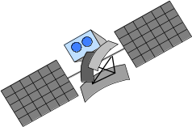
Typical application: road traffic
UMTS, WLAN,
DAB, GSM,
TETRA, ...
ad hoc
Personal Travel Assistant,
DAB, PDA, laptop,
GSM, UMTS, WLAN,
Bluetooth, ...

Slide 6

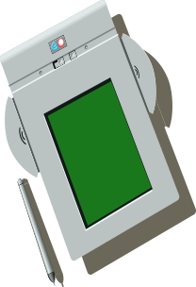
Applications II
Travelling salesmen
  direct access to customer files stored in a central location
  consistent databases for all agents
  mobile office
Replacement of fixed networks
  remote sensors, e.g., weather, earth activities
  flexibility for trade shows
  LANs in historic buildings
Entertainment, education, ...
  outdoor Internet access
  intelligent travel guide with up-to-date
  location dependent information
  ad-hoc networks for
  multi user games
Built
150BC
1.5.1

Slide 7
Location dependent services
Location aware services
  what services, e.g., printer, fax, phone, server etc. exist in the local environment
Follow-on services
  automatic call-forwarding, transmission of the actual workspace to the current location
Information services
  „push“: e.g., current special offers in the supermarket
  „pull“: e.g., where is the Black Forrest Cherry Cake?
Support services
  caches, intermediate results, state information etc. „follow“ the mobile device through the fixed network
Privacy
  who should gain knowledge about the location
1.6.1

Slide 8
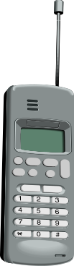
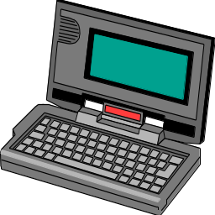
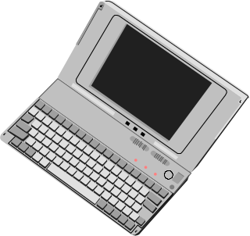

Mobile devices
Pager
receive only
tiny displays
simple text
messages
PDA
simple graphical displays
character recognition
simplified WWW
Laptop
fully functional
standard applications
Sensors,
embedded
controllers
Mobile phones
voice, data
simple text displays
Palmtop
tiny keyboard
simple versions
of standard applications
performance
1.7.1

Slide 9
Effects of device portability
Power consumption
  limited computing power, low quality displays, small disks due to limited battery capacity
  CPU: power consumption ~ CV²f
    C: internal capacity, reduced by integration
    V: supply voltage, can be reduced to a certain limit
    f: clock frequency, can be reduced temporally
Loss of data
  higher probability, has to be included in advance into the design (e.g., defects, theft)
Limited user interfaces
  compromise between size of fingers and portability
  integration of character/voice recognition, abstract symbols
Limited memory
  limited value of mass memories with moving parts
  flash-memory or ? as alternative
1.8.1

Slide 10
Wireless networks in comparison to fixed networks
Higher loss-rates due to interference
  emissions of, e.g., engines, lightning
Restrictive regulations of frequencies
  frequencies have to be coordinated, useful frequencies are almost all occupied
Low transmission rates
  local some Mbit/s, regional currently, e.g., 9.6kbit/s with GSM
Higher delays, higher jitter
  connection setup time with GSM in the second range, several hundred milliseconds for other wireless systems
Lower security, simpler active attacking
  radio interface accessible for everyone, base station can be simulated, thus attracting calls from mobile phones
Always shared medium
  secure access mechanisms important
1.9.1

Slide 11
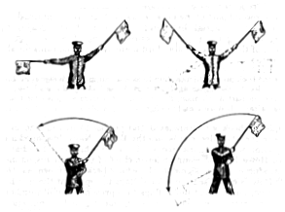
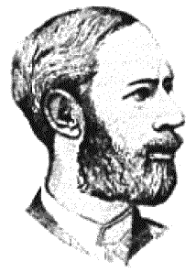
Early history of wireless communication
Many people in history used light for communication
  heliographs, flags („semaphore“), ...
  150 BC smoke signals for communication;
  (Polybius, Greece)
  1794, optical telegraph, Claude Chappe
Here electromagnetic waves are
of special importance:
  1831 Faraday demonstrates electromagnetic induction
  J. Maxwell (1831-79): theory of electromagnetic Fields, wave equations (1864)
  H. Hertz (1857-94): demonstrates
  with an experiment the wave character
  of electrical transmission through space
  (1886, in Karlsruhe, Germany, at the
  location of today’s University of Karlsruhe)
1.10.1

Slide 12
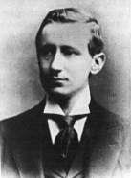
History of wireless communication I
1895 Guglielmo Marconi
  first demonstration of wireless
  telegraphy (digital!)
  long wave transmission, high
  transmission power necessary (> 200kw)
1907 Commercial transatlantic connections
  huge base stations
  (30 100m high antennas)
1915 Wireless voice transmission New York - San Francisco
1920 Discovery of short waves by Marconi
  reflection at the ionosphere
  smaller sender and receiver, possible due to the invention of the vacuum tube (1906, Lee DeForest and Robert von Lieben)
1926 Train-phone on the line Hamburg - Berlin
  wires parallel to the railroad track
1.11.1

Slide 13
History of wireless communication II
1928 many TV broadcast trials (across Atlantic, color TV, TV news)
1933 Frequency modulation (E. H. Armstrong)
1958 A-Netz in Germany
  analog, 160MHz, connection setup only from the mobile station, no handover, 80% coverage, 1971 11000 customers
1972 B-Netz in Germany
  analog, 160MHz, connection setup from the fixed network too (but location of the mobile station has to be known)
  available also in A, NL and LUX, 1979 13000 customer in D
1979 NMT at 450MHz (Scandinavian countries)
1982 Start of GSM-specification
  goal: pan-European digital mobile phone system with roaming
1983 Start of the American AMPS (Advanced Mobile Phone System, analog)
1984 CT-1 standard (Europe) for cordless telephones
1.12.1

Slide 14
History of wireless communication III
1986 C-Netz in Germany
  analog voice transmission, 450MHz, hand-over possible, digital signaling, automatic location of mobile device
  still in use today (as T-C-Tel), services: FAX, modem, X.25, e-mail, 98% coverage
1991 Specification of DECT
  Digital European Cordless Telephone (today: Digital Enhanced Cordless Telecommunications)
  1880-1900MHz, ~100-500m range, 120 duplex channels, 1.2Mbit/s data transmission, voice encryption, authentication, up to several 10000 user/km², used in more than 40 countries
1992 Start of GSM
  in D as D1 and D2, fully digital, 900MHz, 124 channels
  automatic location, hand-over, cellular
  roaming in Europe - now worldwide in more than 100 countries
  services: data with 9.6kbit/s, FAX, voice, ...
1.13.1

Slide 15
History of wireless communication IV
1994 E-Netz in Germany
  GSM with 1800MHz, smaller cells, supported by 11 countries
  as Eplus in D (1997 98% coverage of the population)
1996 HiperLAN (High Performance Radio Local Area Network)
  ETSI, standardization of type 1: 5.15 - 5.30GHz, 23.5Mbit/s
  recommendations for type 2 and 3 (both 5GHz) and 4 (17GHz) as wireless ATM-networks (up to 155Mbit/s)
1997 Wireless LAN - IEEE802.11
  IEEE-Standard, 2.4 - 2.5GHz and infrared, 2Mbit/s
  already many products (with proprietary extensions)
1998 Specification of GSM successors
  for UMTS (Universal Mobile Telecommunication System) as European proposals for IMT-2000
Iridium
  66 satellites (+6 spare), 1.6GHz to the mobile phone
1.14.1

Slide 16
Wireless systems: overview of the development
cellular phones
satellites
cordless
phones
wireless LAN
1980:
CT0
1981:
NMT 450
1982:
Inmarsat-A
1984:
CT1
1983:
AMPS
1986:
NMT 900
1988:
Inmarsat-C
1987:
CT1+
1991:
CDMA
1991:
D-AMPS
1989:
CT 2
199x:
proprietary
1991:
DECT
1992:
GSM
1992:
Inmarsat-B
Inmarsat-M
1993:
PDC
1995/96/97:
IEEE 802.11,
HIPERLAN
1994:
DCS 1800
1998:
Iridium
analog
2005?:
MBS, WATM
2005?:
UMTS/IMT-2000
digital
1.15.1

Slide 17

The future: ITU-R - Recommendations for IMT-2000
M.687-2
  IMT-2000 concepts and goals
M.816-1
  framework for services
M.817
  IMT-2000 network architectures
M.818-1
  satellites in IMT-2000
M.819-2
  IMT-2000 for developing countries
M.1034-1
  requirements for the radio interface(s)
M.1035
  framework for radio interface(s) and radio sub-system functions
M.1036
  spectrum considerations
M.1078
  security in IMT-2000
M.1079
  speech/voiceband data performance
M.1167
  framework for satellites
M.1168
  framework for management
M.1223
  evaluation of security mechanisms
M.1224
  vocabulary for IMT-2000
M.1225
  evaluation of transmission technologies
. . .
http://www.itu.int/imt
1.16.1

Slide 18
Worldwide wireless subscribers (prediction)
700
600
500
Americas
400
Europe
Japan
300
others
total
200
100
0
1996
1997
1998
1999
2000
2001
1.17.1

Slide 19
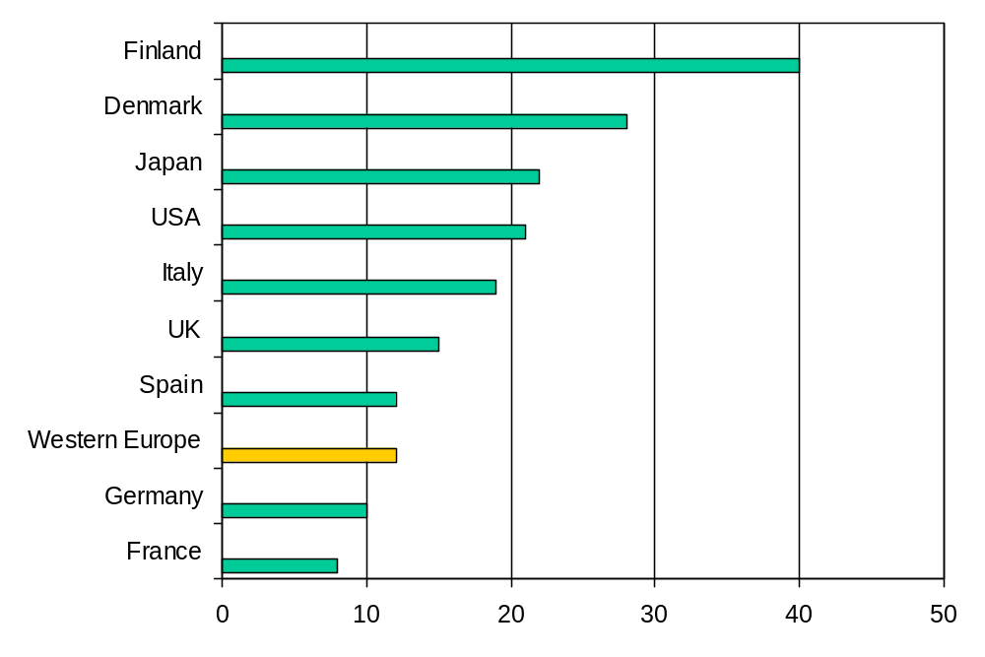
Mobile phones per 100 people 1997
1998: 40% growth rate in Germany
1.18.1

Slide 20
Areas of research in mobile communication
Wireless Communication
  transmission quality (bandwidth, error rate, delay)
  modulation, coding, interference
  media access, regulations
  ...
Mobility
  location dependent services
  location transparency
  quality of service support (delay, jitter, security)
  ...
Portability
  power consumption
  limited computing power, sizes of display, ...
  usability
  ...
1.19.1

Slide 21
Simple reference model used here
Application
Application
Transport
Transport
Network
Network
Network
Network
Data Link
Data Link
Data Link
Data Link
Physical
Physical
Physical
Physical
Radio
Medium
1.20.1

Slide 22
Influence of mobile communication to the layer model
Application layer
Transport layer
Network layer
Data link layer
Physical layer
  service location
  new applications, multimedia
  adaptive applications
  congestion and flow control
  quality of service
  addressing, routing,
  device location
  hand-over
  authentication
  media access
  multiplexing
  media access control
  encryption
  modulation
  interference
  attenuation
  frequency
1.21.1

Slide 23
Overview of the chapters
Chapter 11:
Support for Mobility
Chapter 10:
Mobile Transport Layer
Chapter 9:
Mobile Network Layer
Chapter 4:
Telecommunication
Systems
Chapter 5:
Satellite
Systems
Chapter 6:
Broadcast
Systems
Chapter 7:
Wireless
LAN
Chapter 8:
Wireless
ATM
Chapter 3:
Medium Access Control
Chapter 2:
Wireless Transmission
1.22.1

Slide 24





Overlay Networks - the global goal
integration of heterogeneous fixed and
mobile networks with varying
transmission characteristics
regional
vertical
hand-over
metropolitan area
campus-based
horizontal
hand-over
in-house
1.23.1

